Slide 1
IT1212 System Analysis & Design
System Implementation

Slide 2
System Implementation includes
Source code
Database
User documentation
Testing
Staff training
File conversion

Slide 3
Source code
Source code may be in one of the following categories
Standard off- the –shelf package
Bespoke package
Amended standard package
standard package plus additions

Slide 4
Standard off- the –shelf package
The organization purchases and installs a ready-made solution.
Advantages:
Available immediately
Cheaper
High quality
Can be update
Relatively free of bugs
Easy to handle
Disadvantages
It may be not well suited
Competitors may well use the same package.

Slide 5
The factors to consider when choosing an off-the –shelf application package
User requirements - does the package fit the user's requirements
Processing times – Are the processing time fast enough?
Documentation – Is there full and clear documentation for the user?
Compatibility-Is the package compatible with existing hardware and software?
Controls – Access and security controls should be included
User-interface – the interface should be clear, logical and consistent
Modification – can the package be modified by the user
Support maintenance and update
cost

Slide 6
2. Bespoke package
Programmers write an application to meet the specific needs of the organization.
This can be a time-consuming and expensive process
It is involves all the tasks included in the software development and testing cycle

Slide 7
advantages
The software should meet the organization's specific needed.
Competitive advantage
It can make modification for future needs
Disadvantages:
It make risk
Greater chance of bugs
Waste time and cost

Slide 8
3. Amended standard package
A standard package is purchased, but some customization is undertaken so that the software meets the organizations requirements.
This may require access to the source code.
Development time should be much quicker.
User can get good knowledge about the software

Slide 9
4. standard package plus additions
The purchased standard package is not amended itself, but additional software that integrates with the standard package is developed. This also may require access to the source code.

Slide 10
User Documentation

Slide 11
User documentation
Written or visual information about an application system, how it works, and how to use it.
Contains an overview, index, getting started instructions, I.e. – very structured
Describes functionalities
Contains task-based documentation
“How to’s…”
Frequently Asked Questions
Messages & their meanings

Slide 12
Technical manual
The technical manual should include the following;
Contact details for the original developers
System overview
System specifications including performance details
Hardware technical specification
System objectives
Flowcharts or Data flow diagrams
Entity models and life histories
Individual program specifications
Data dictionary

Slide 13
User manual
The manual provides full documentation of the operational procedures necessary for the ‘hands-on’ running of the system;
Systems set-up procedures
Security procedures
Reconstruction control procedures
System messages
samples

Slide 14
Staff training

Slide 15
Staff training
Senior management training
Executive Support System and Decision Support System
Awareness of information technology, project mgt. skills
Middle managers training
Computing skill
Management information system
Office type software
Operational staff
Training should focus on specific tasks

Slide 16
File Conversion

Slide 17
File conversion
This may be according to one of four approaches
Direct changeover
Parallel running
Pilot operation
Phased changeover
17

Slide 18
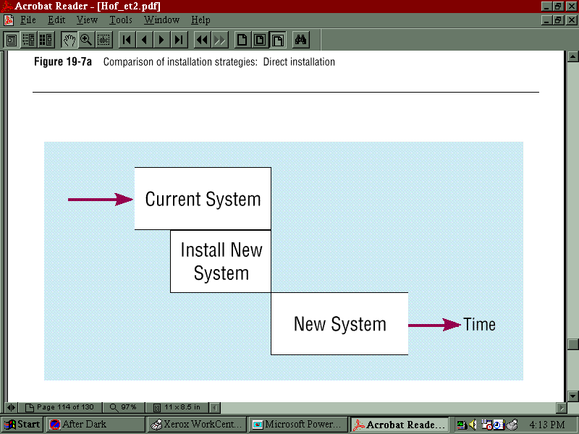
1. Direct changeover
The old system is completely replaced by the new system in one move
18

Slide 19
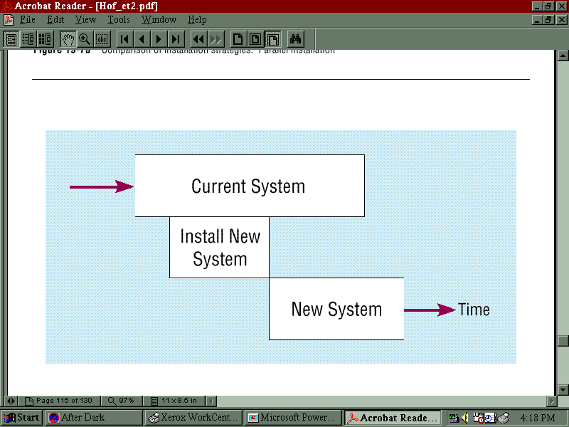
2. Parallel running
The old and new systems are run in parallel for a period of time.
19

Slide 20
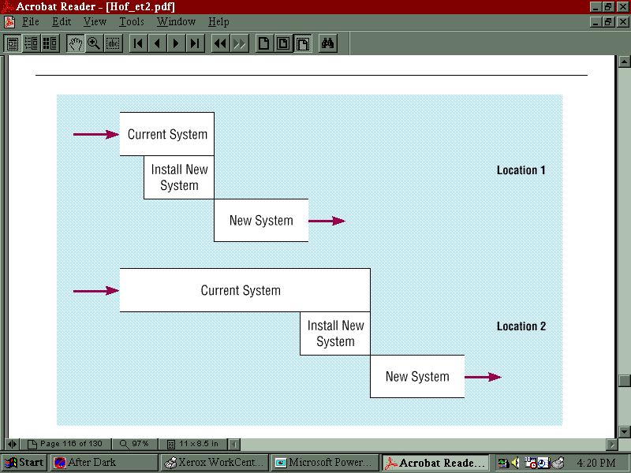
Pilot operation
The pilot operation involves selecting part or parts of an organization to operate running the new system in parallel with the existing system. When the branch or department piloting the system is satisfied with the new system, they cease to use the old system. The new system is then piloted in another area of the organization.

Slide 21
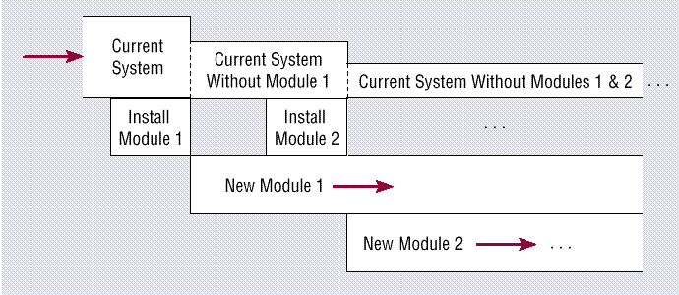
Phased changeover
Selecting a complete section of the system for a direct changeover. Introduce the rest phase by phase.

Slide 22
Method | Advantages | Disadvantages
Direct changeover | Quick Minimal cost Minimizes workload | Risky Could disrupt operations If fails, will be costly
Parallel running | Safe, built-in safety Provides way of verifying results of new system | Costly-two systems need to be operated Time –consuming Additional workload
22

Slide 23
Method | Advantages | Disadvantages
Pilot operation | Less risky than direct changeover Less costly than complete parallel running | Can take a long time to achieve Total changeover Not as safe as complete parallel running
Phased changeover | Less risky than a single direct changeover Any problems should be in one area-other operations unaffected | Can take a long time to achieve total changeover Interfaces between parts of the system may make this impractical

